Slide 1
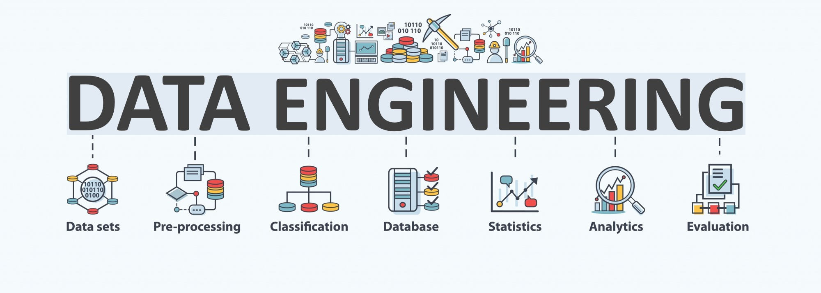

Lecture 8: Data Driven Applications (2) -- Social Network Analysis and Anomaly Detection
CS5481 Data Engineering
Instructor: Yifan Zhang

Slide 2
Outline
Social network analysis
Anomaly detection

Slide 3
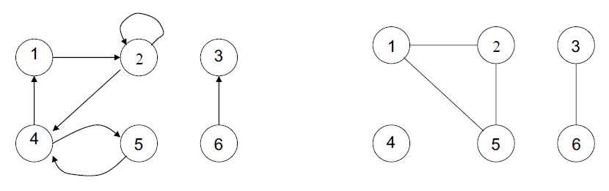
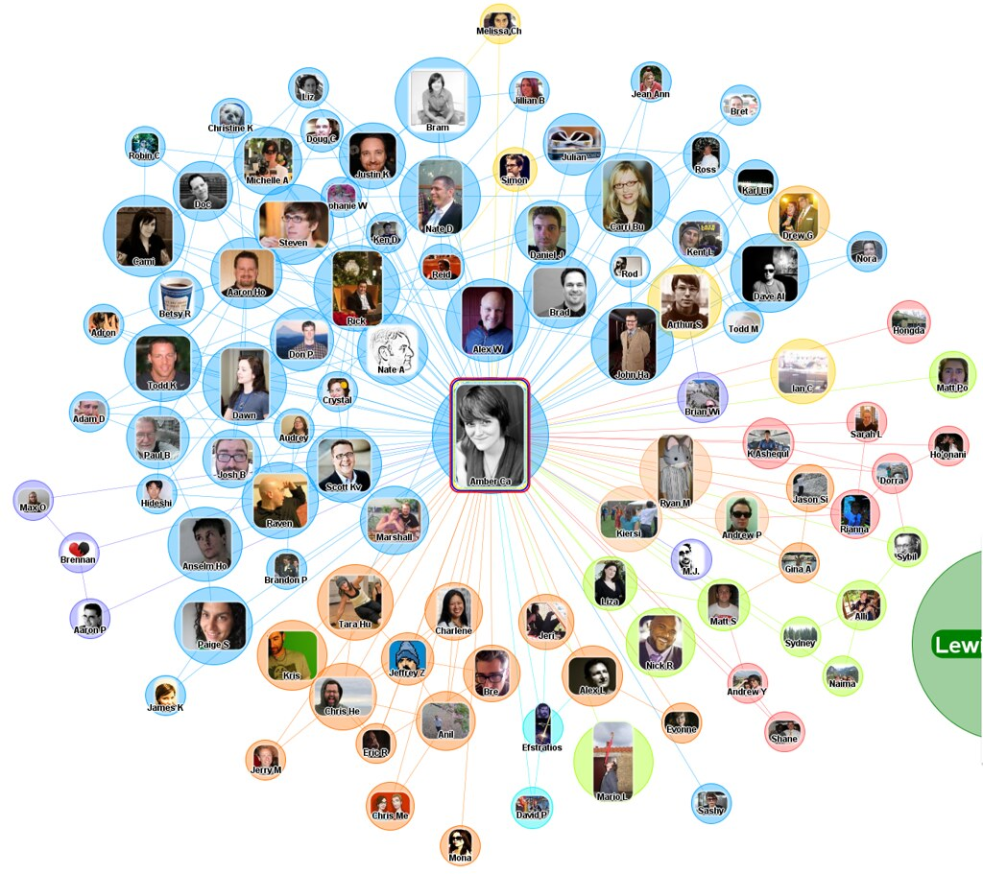
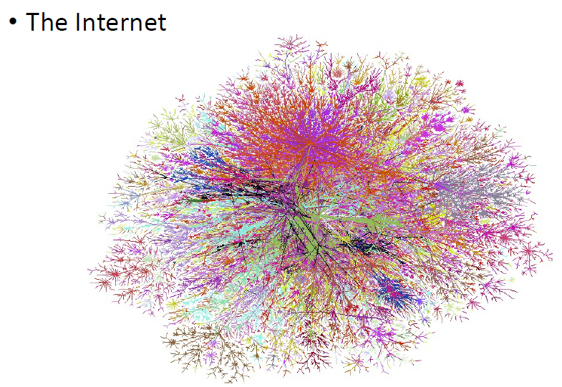
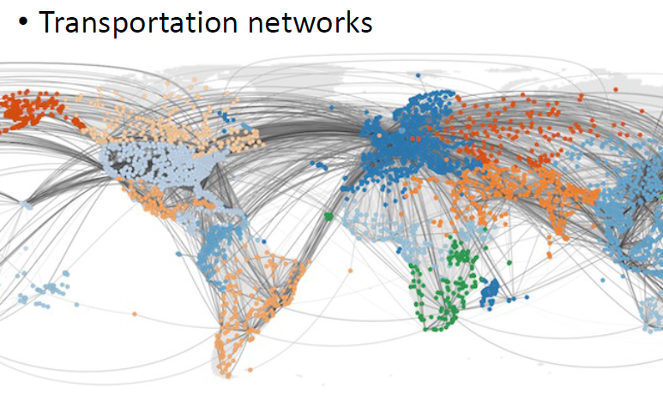
Networks
What is a Network?
Network = Graph
Informally a graph is a set of nodes joined by a set of lines or arrows.
Real-World Networks
Social networks

Slide 4
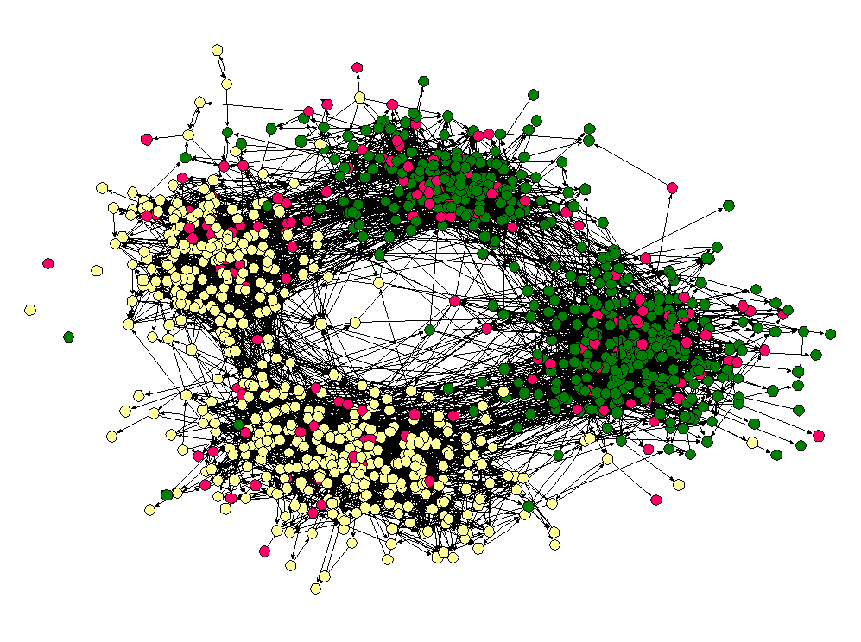
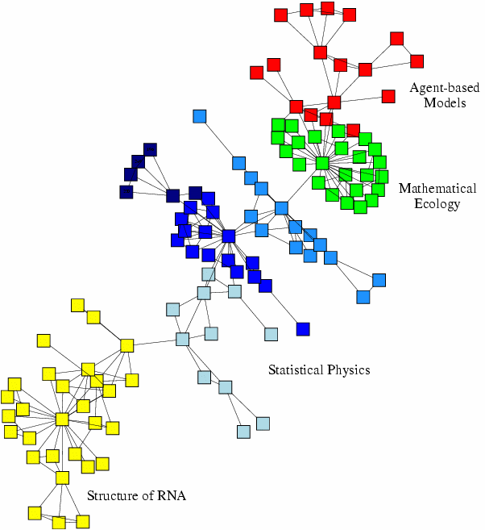
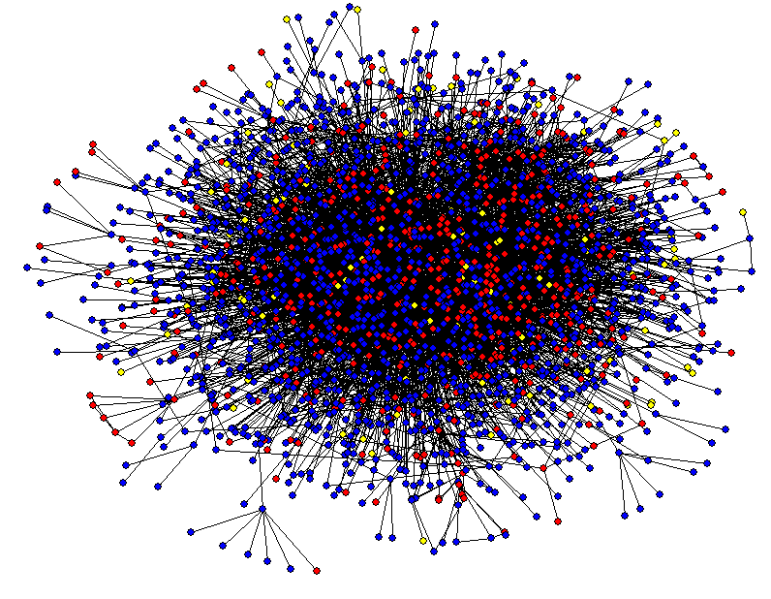
More real-world networks
Friendship network
Scientific collaboration network
Protein-protein interaction networks

Slide 5
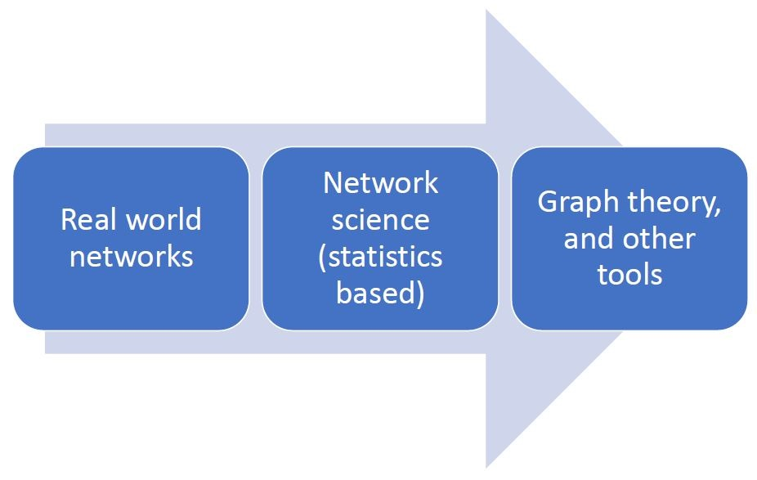
Social network analysis – graph theory
Graph theory is a branch of discrete mathematics concerned with proving theorems and developing algorithms for arbitrary graphs (e.g. random graphs, lattices, hierarchies).
Graph theory and network science

Slide 6
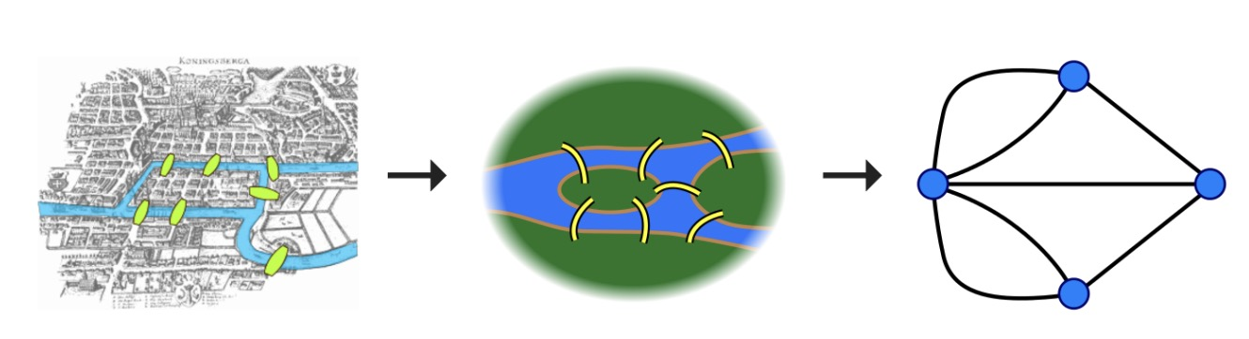
Social network analysis – graph
What makes a problem graph-like?
There are two components to a graph
Nodes and edges
In graph-like problems, these components have natural correspondences to problem elements
Entities are nodes and interactions between entities are edges
Most complex systems are graph-like
Map of Konigsberg in Euler’s time showing the actual layout of the seven bridges, highlighting the river Pregel and the bridges. Graphs can be used to remove unnecessary (geographical) details, in order to highlight the connectivity patterns between different areas. Taken from Wikipedia.

Slide 7
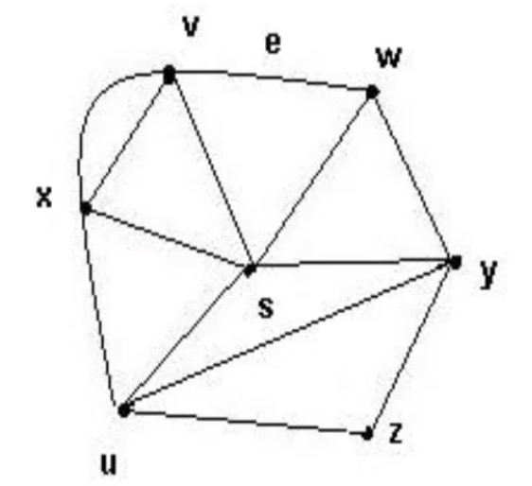
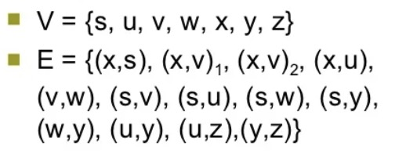
Graph theory
G is an ordered triple G:=(V, E)
• V is a set of nodes, points, or vertices.
• E is a set, whose elements are known as edges, arcs, or lines.
Node (Vertex)
• Basic Element
• Drawn as a node or a dot.
• Vertex set of G is usually denoted by V(G), or V
Edge (Arc, link)
• A set of two elements
• Drawn as a line connecting two vertices, called end vertices, or endpoints.
• The edge set of G is usually denoted by E(G), or E.

Slide 8
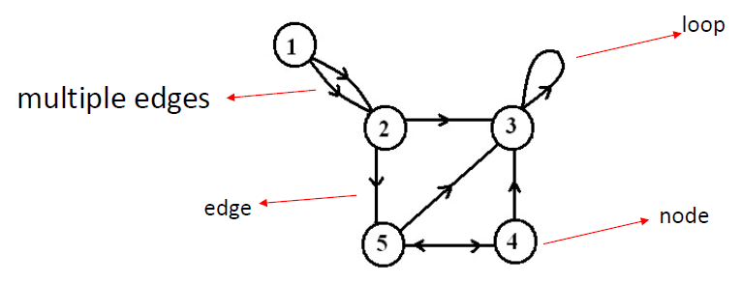
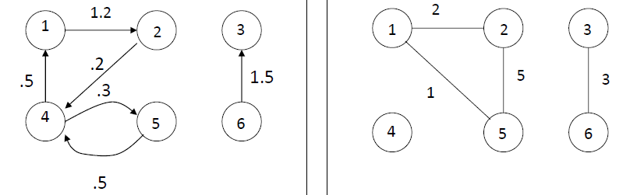
Undirected, directed, weighted networks
Undirected Network
In an undirected graph or network, the edges are reciprocal—so if A is connected to B, B is by definition connected to A.
Directed Network
Edges have directions: an edge is an ordered pair of nodes
Weighted Network
Weighted network is a graph for which each edge has an associated weight, usually given by a weight function w: E->R.

Slide 9
Examples of undirected, directed, weighted networks
With whom do you work?
= undirected relationship
A
B
Who do you ask for help/Who do you give advice?
= directed relationship
A
B
How often? Eg never, monthly, weekly, daily?
= strength of relationships
A
B
Q1: With whom do you work?
Q2: With whom do you have a drink?
= multiplexity of relationships
A
B

Slide 10
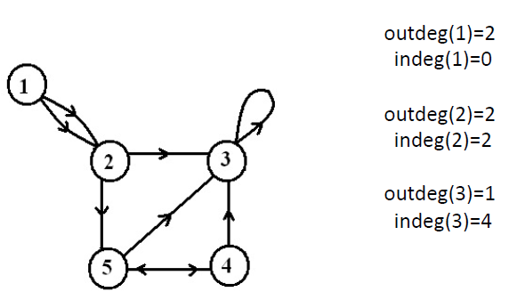
In- and out-degrees
In-degree: number of edges entering.
Out-degree: number of edges leaving.
Degree = in-degree + out-degree

Slide 11
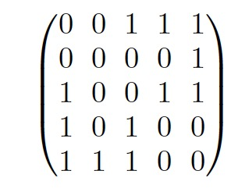
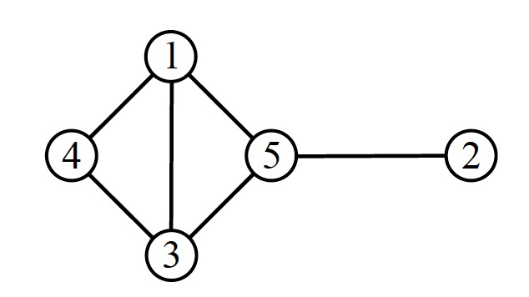
Graph representation
Adjacency matrix
Use a matrix to represent the graph vertices and edges
An n*n matrix with n vertices.
The (i,j) entry denotes the edges
Undirected/Directed: 1/0 denotes with/without an edge for vertices i and j.
Weighted: a positive value denotes the weight

Slide 12
Social network analysis
Social Network:
A set of individual actors (= people) connected through social relationships
Social Network Analysis (SNA):
is a diagnostic method for collecting and analysing data about the patterns of relationships among people in groups. A systematic approach to make the invisible flows within an organisation visible

Slide 13
Sociograms
A sociogram is a graphic representation of social links that a person has. It is a graph drawing that plots the structure of interpersonal relations in a group situation.
Peripheral individual
Nodes are individuals or organizational units
Cluster
Central individual
Links represent relationships (e.g. “friend of”), mono or bi-directional

Slide 14
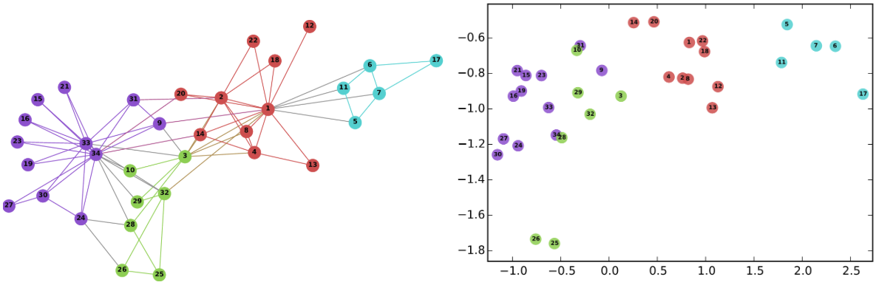
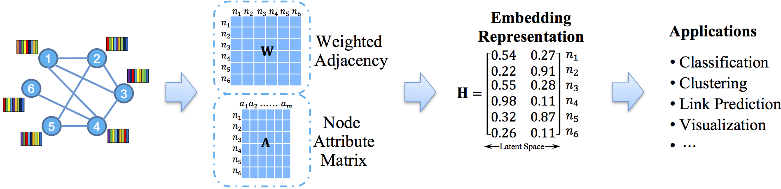
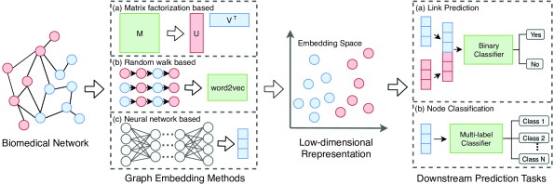
Network embedding
Network embedding: mapping graph nodes to vectors of real numbers in a multidimensional space.
Methods
Spectrum or factorization based (analysing adjacency matrix)
Random walk based (random walk over the graph to generate sequences)
Neural network based (learning on graph structure, e.g., GNN)

Slide 15
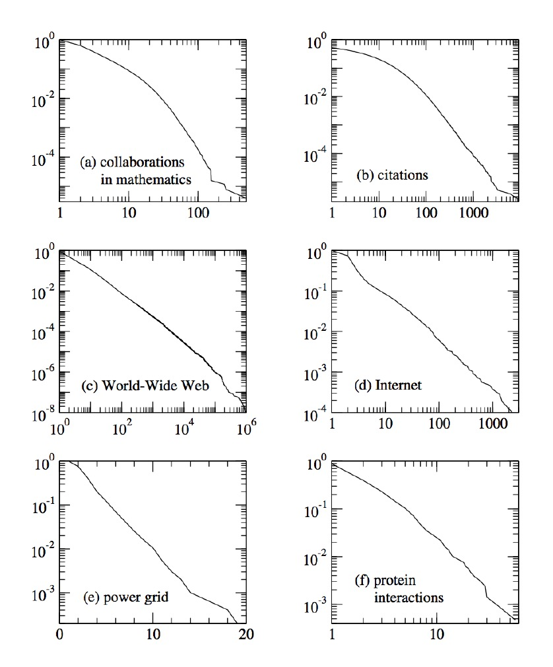
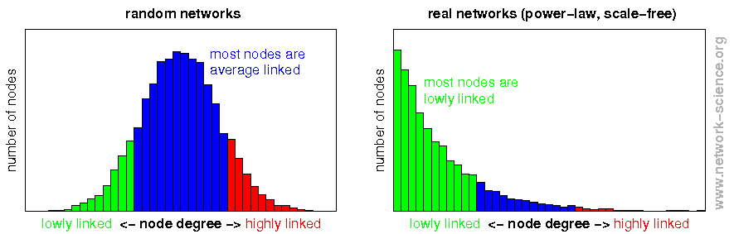
Social network analysis – distributions
Distribution of degrees
Horizontal axis: degrees; vertical axis: number of vertices
Common distributions: power law with long-tail, Gaussian (bell shape)

Slide 16
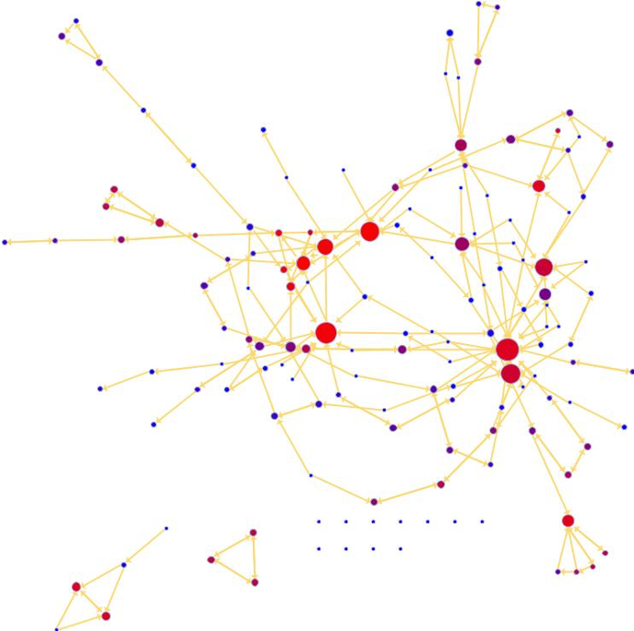
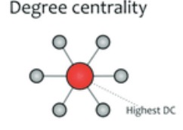
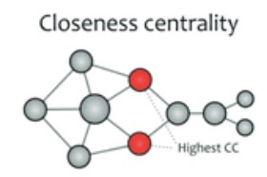
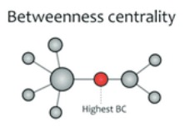
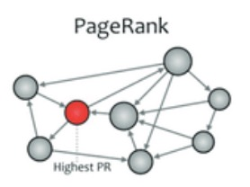
Social network analysis – centrality
Centrality measures aim to quantify the importance of nodes in a network.
Degree centrality: based on degrees
Closeness centrality: based on distance from other nodes.
Betweenness centrality: based # paths going through
Importance centrality: based on weights of nodes, such as PageRank.

Slide 17
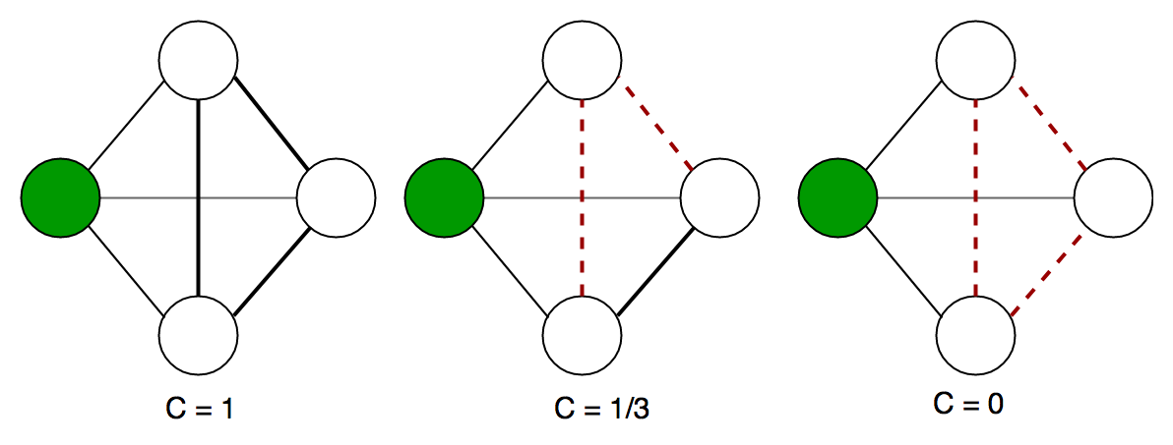
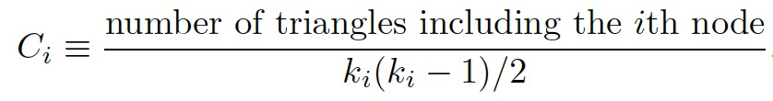
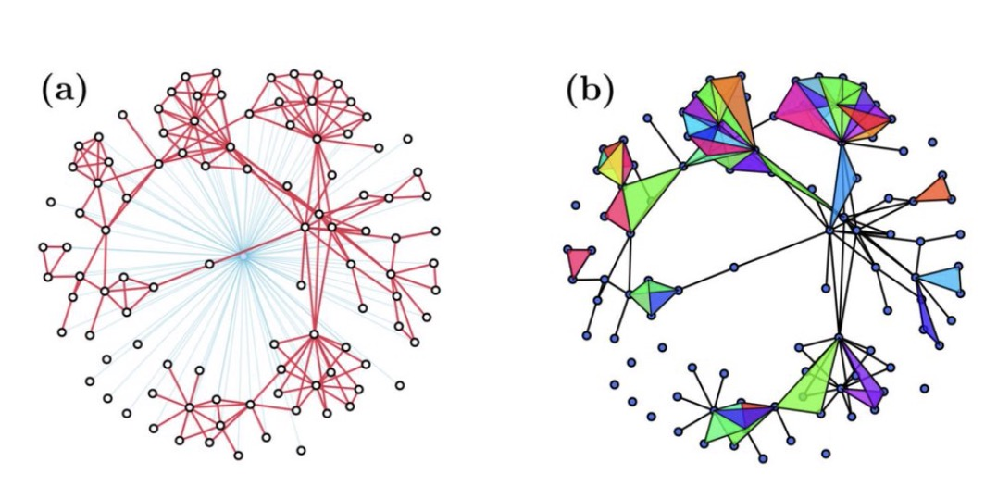
Social network analysis – Local cohesion
Clustering coefficient
The amount of triangles in a network is quantified by the clustering coefficient of a node.
Local cohesion: the clustering coefficient measures the cohesion level
E.g., if all three are friends (a triangle), then they are cohesive; if two friends are enemies (not connected), then they are not cohesive.
# possible triangles connecting to node i

Slide 18
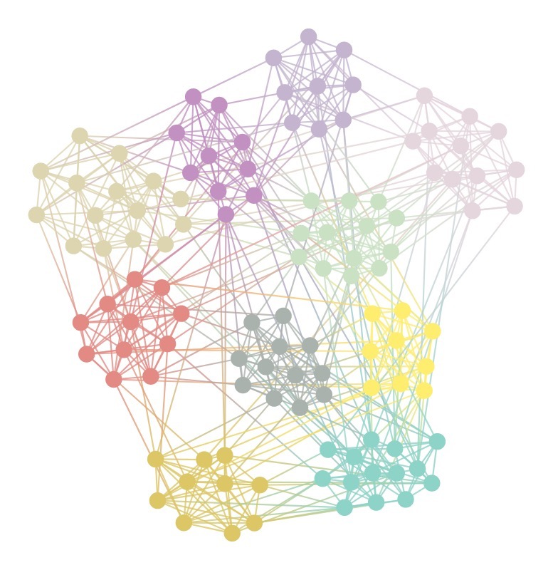
Social network analysis – community detection
Community detection, also called graph partition, helps us to reveal the hidden relations among the nodes in the network.
If the graph has the community structure, then its nodes can be easily grouped into sets of nodes such that each set of nodes is densely connected internally.
Social networks include community groups based on common location, interests, occupation, etc. E.g., citation networks form communities by research topics.
Being able to identify these sub-structures within a network can provide insight into how network function and topology affect each other.
Communities often have very different properties than the average properties of the networks. Thus, only concentrating on the average properties usually misses many important and interesting features inside the networks.

Slide 19
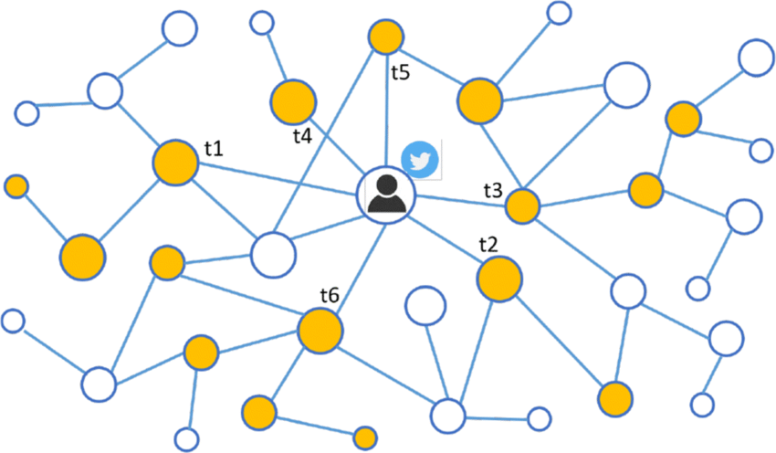




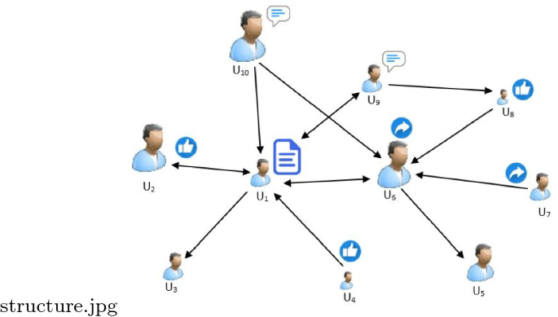
Social network analysis – network propagation
Network propagation refers to a class of algorithms that integrate information from input data across connected nodes in a given network.
Study the dynamics of network propagation, i.e., how data/information is spread across networks, and how networks are influenced in the meantime.
Epidemic/Virus spread model
Applications
News/Tweets/Memes/Trends propagation
Rumer/Fake news detection
Tweets propagation
Memes = social genes
Fake news detection

Slide 20
Challenges in social network analysis
Heterogeneity of social networks: size, data, structure, etc.
Scalability: how to deal with large-scale social networks?
Missing, incomplete, and unstructured data
Model accuracy

Slide 21
Anomaly detection overview
Anomaly detection: the identification of rare items, events or observations which deviate significantly from the majority of the data and do not conform to a well defined notion of normal behavior.
Historically, the field of statistics tried to find and remove outliers as a way to improve analyses.
There are now many fields where the outliers / anomalies are the objects of greatest interest.
The rare events may be the ones with the greatest impact, and often in a negative way.

Slide 22
Causes of Anomalies
Data from different class of object or underlying mechanism
disease vs. non-disease
fraud vs. not fraud
Natural variation
tails on a Gaussian distribution
Data measurement and collection errors

Slide 23
Structure of anomalies
Point anomalies
Contextual anomalies
Collective anomalies

Slide 24
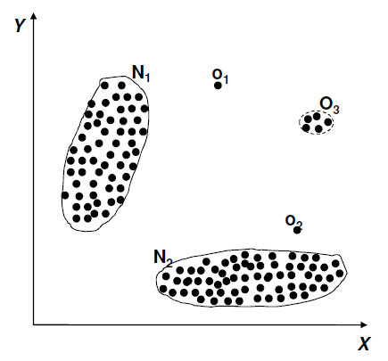
Point anomalies
An individual data instance is anomalous with respect to the data

Slide 25
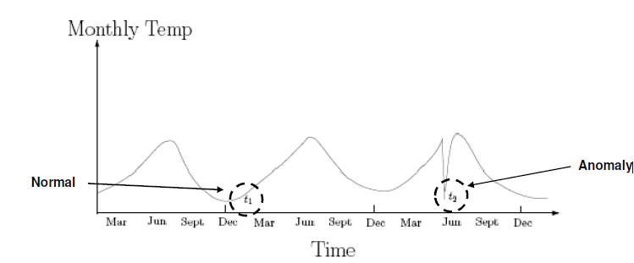
Contextual anomalies
An individual data instance is anomalous within a context
By combining with contexts: circumstances that form the setting for an event, statement, or idea, and in terms of which it can be fully understood, such as time, location, and related events.
Also referred to as conditional anomalies

Slide 26
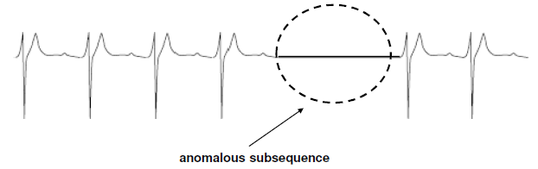
Collective anomalies
A collection of related data instances is anomalous
Requires a relationship among data instances
Sequential data
Spatial data
Graph data
The individual instances within a collective anomaly are not anomalous by themselves

Slide 27
Applications of anomaly detection
Network intrusion
Insurance / credit card fraud
Healthcare informatics / medical diagnostics
Industrial damage detection
Image processing / video surveillance
Novel topic detection in text mining
…

Slide 28
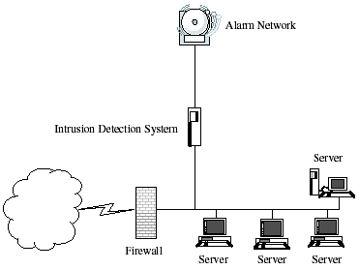
Network intrusion detection
Intrusion Detection
Monitor events occurring in a computer system or network and analyze them for intrusions
Intrusions defined as attempts to bypass the security mechanisms of a computer or network
Challenges
Traditional intrusion detection systems are based on signatures of known attacks and cannot detect emerging cyber threats
Substantial latency in deployment of newly created signatures across the computer system
Anomaly detection can alleviate these limitations

Slide 29
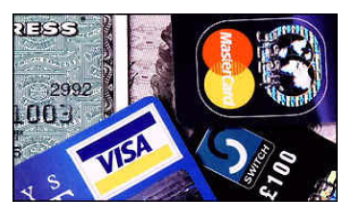
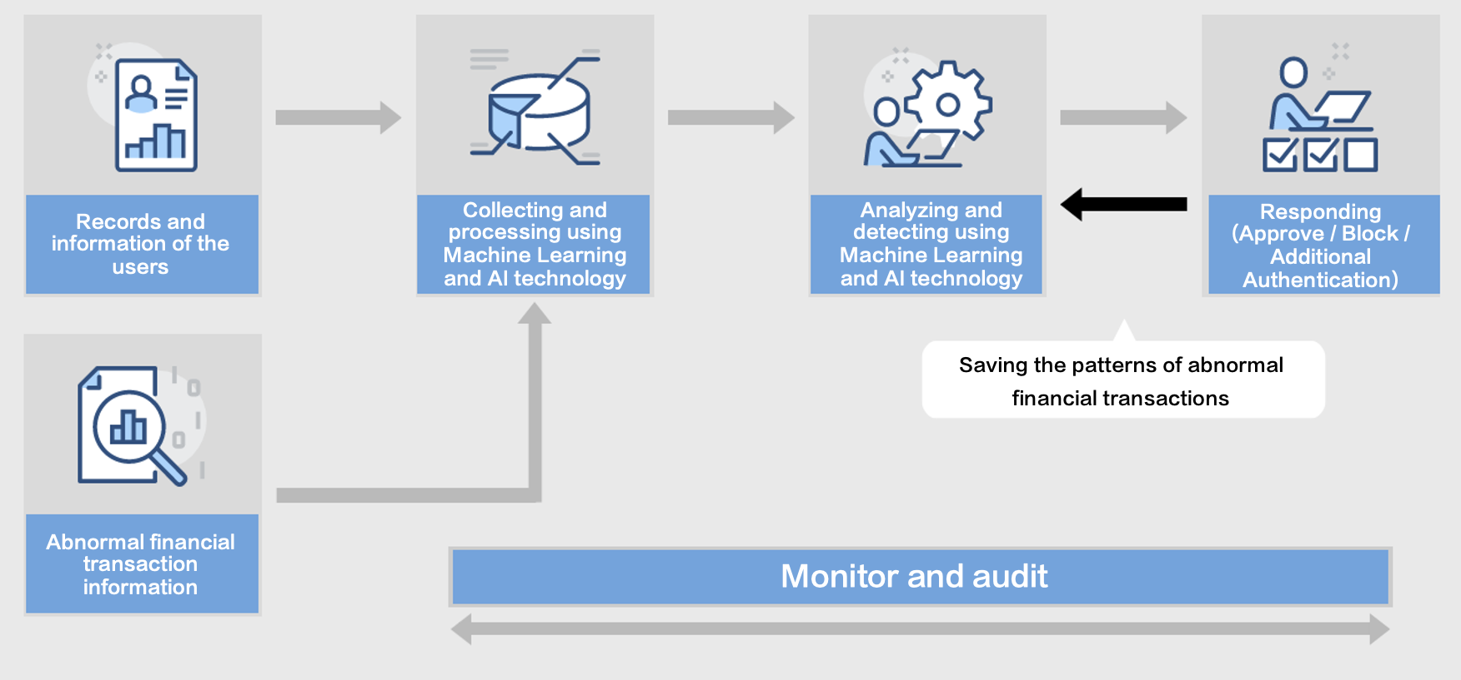
Credit card fraud detection
Fraud Detection
Detection of criminal activities occurring in commercial organizations.
Malicious users might be:
Employees
Actual customers
Someone posing as a customer (identity theft)
Types of fraud
Credit card fraud
Insurance claim fraud
Mobile / cell phone fraud
Insider trading
Challenges
Fast and accurate real-time detection
Misclassification cost is very high

Slide 30

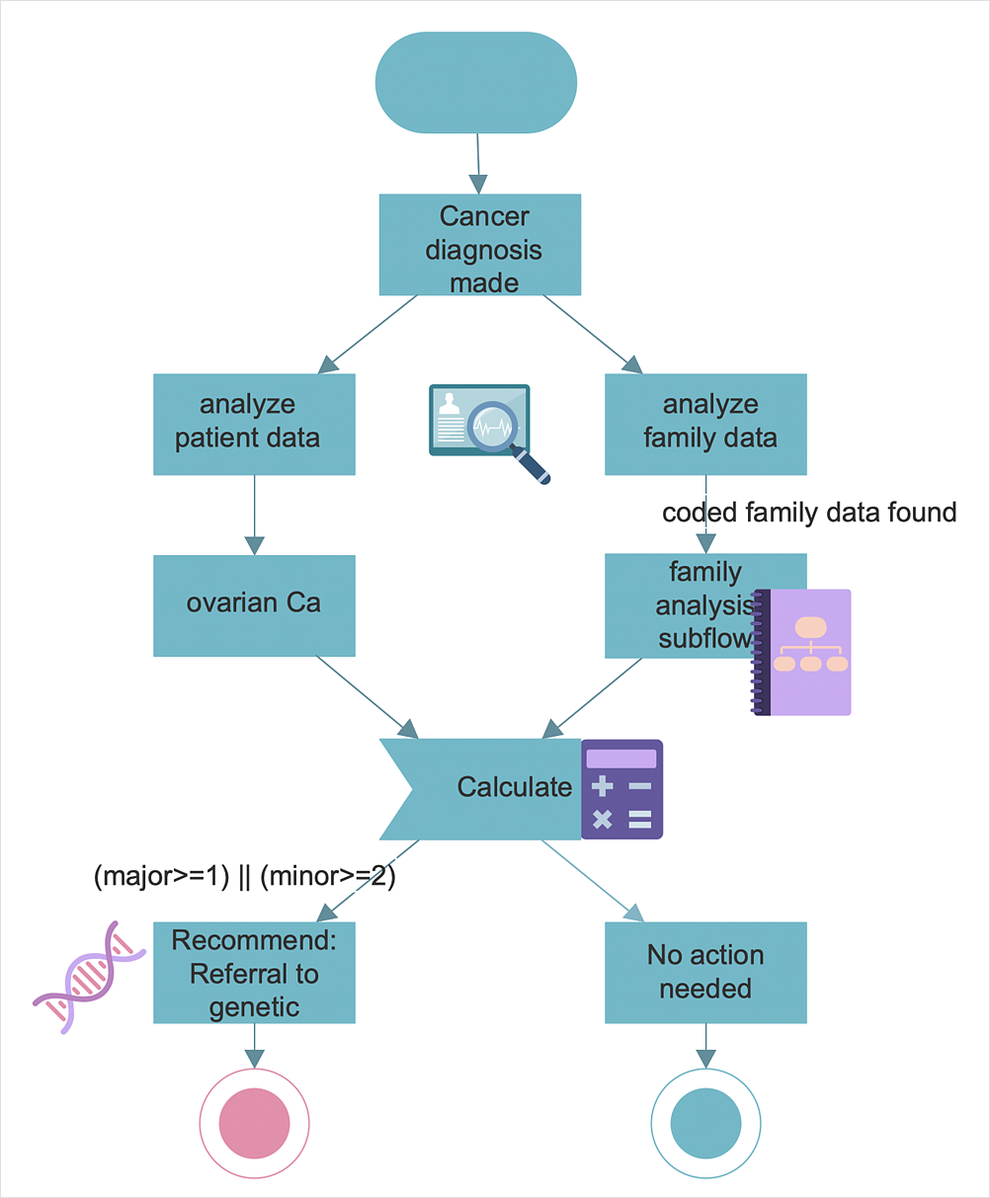
Healthcare diagnosis informatics
Detect anomalous patient records
Indicate disease outbreaks, instrumentation errors, etc.
Key challenges
Only normal labels available
Misclassification cost is very high
Data can be complex: spatio-temporal

Slide 31

Industrial damage detection
Detect faults and failures in complex industrial systems, structural damages, intrusions in electronic security systems, suspicious events in video surveillance, abnormal energy consumption, etc.
Example: aircraft safety
anomalous aircraft (engine) / fleet usage
anomalies in engine combustion data
total aircraft health and usage management
Key challenges
Data is extremely large, noisy, and unlabelled
Most of applications exhibit temporal behavior
Detected anomalous events typically require immediate intervention

Slide 32
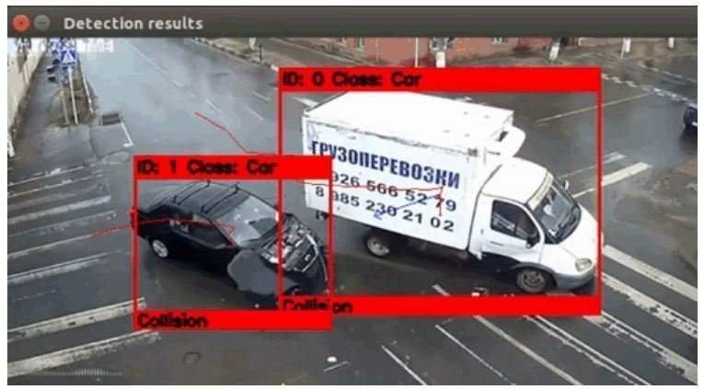
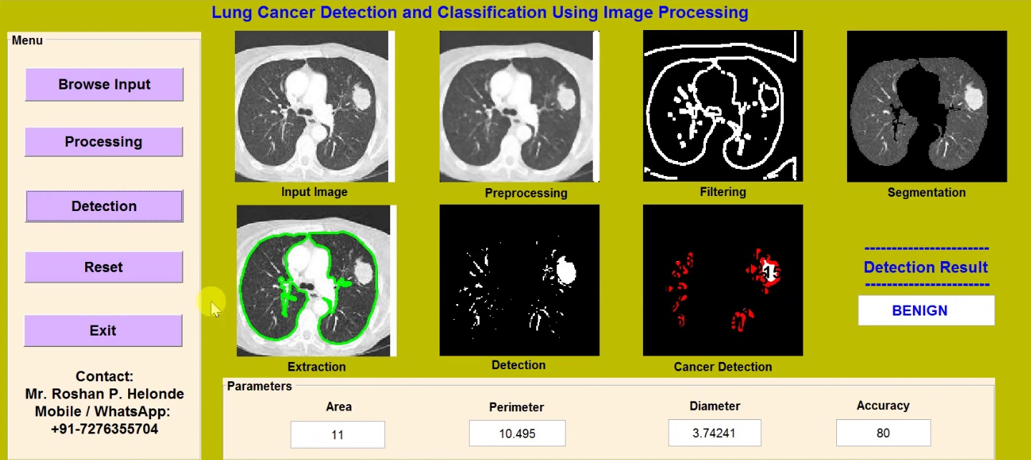
Image processing
Detecting outliers in a image monitored over time.
Detecting anomalous regions within an image.
Used in
mammography image analysis
video surveillance: e.g., traffic accident detection
satellite image analysis
Key Challenges
Detecting collective anomalies
Data sets are very large

Slide 33
Output of anomaly detection
Label
Each test instance is given a normal or anomaly label
Typical output of classification-based approaches
Score
Each test instance is assigned an anomaly score
allows outputs to be ranked
requires an additional threshold parameter

Slide 34
Variants of anomaly detection
Given a dataset D, find all the data points x ∈ D with anomaly scores greater than some threshold t.
Given a dataset D, find all the data points x ∈ D having the top-n largest anomaly scores.
Given a dataset D, containing mostly normal data points, and a test point x, compute the anomaly score of x with respect to D.

Slide 35
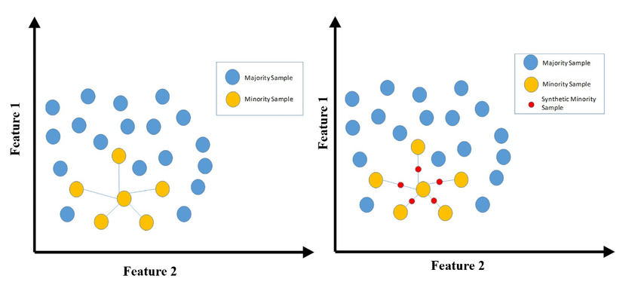
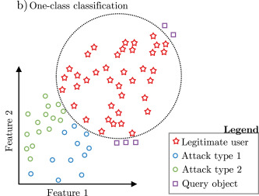
Data labels for anomaly detection
Supervised anomaly detection
Labels available for both normal data and anomalies
Similar to classification with high class imbalance
Data augmentation solution: SMOTE (Synthetic Minority Oversampling TEchnique) is an oversampling technique where the synthetic samples are generated for the minority class.
Semi-supervised anomaly detection
Labels available only for normal data
One class classification solution: only learning normal pattern
Unsupervised anomaly detection
No labels assumed
Based on the assumption that anomalies are very rare compared to normal data

Slide 36
Unsupervised anomaly detection
No labels available
Based on assumption that anomalies are very rare compared to “normal” data
General steps
- Build a profile of “normal” behavior
summary statistics for overall population
model of multivariate data distribution
- Use the “normal” profile to detect anomalies
anomalies are observations whose characteristics differ significantly from the normal profile

Slide 37
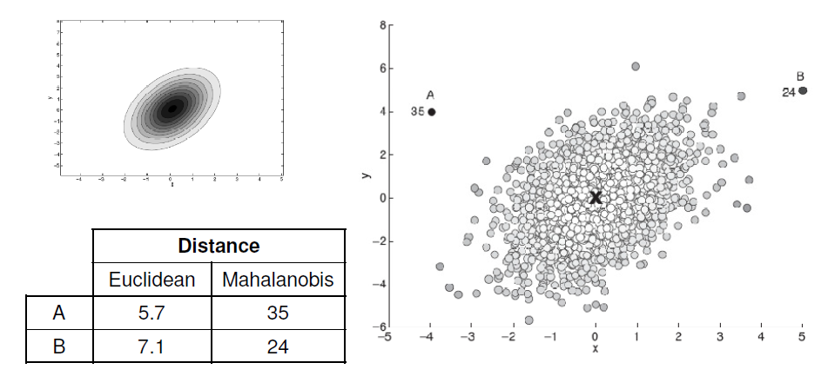
Techniques for unsupervised anomaly detection (1)
Statistical: based on univariate or multivariate Gaussian distribution
Parameters of model (e.g., mean, variance)
Confidence limit (related to number of expected outliers)
Multivariate Gaussian
Univariate Gaussian

Slide 38
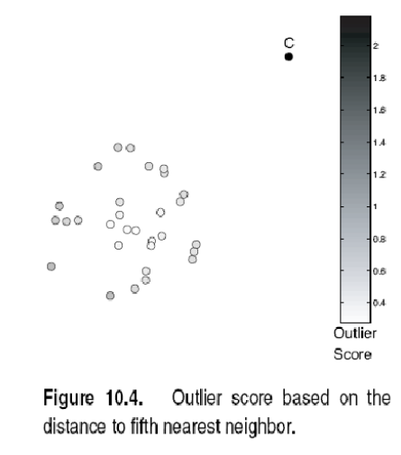
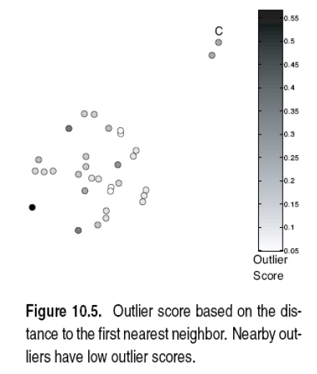
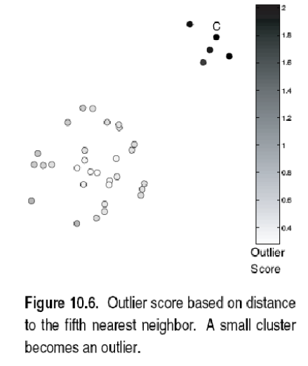
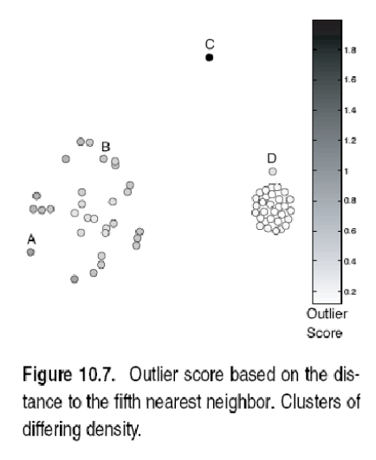
Techniques for unsupervised anomaly detection (2)
Proximity/Distance-based: anomalous data are those that are distant from most of other data
Outlier score is distance to kth nearest neighbor.
Score sensitive to choice of k.

Slide 39
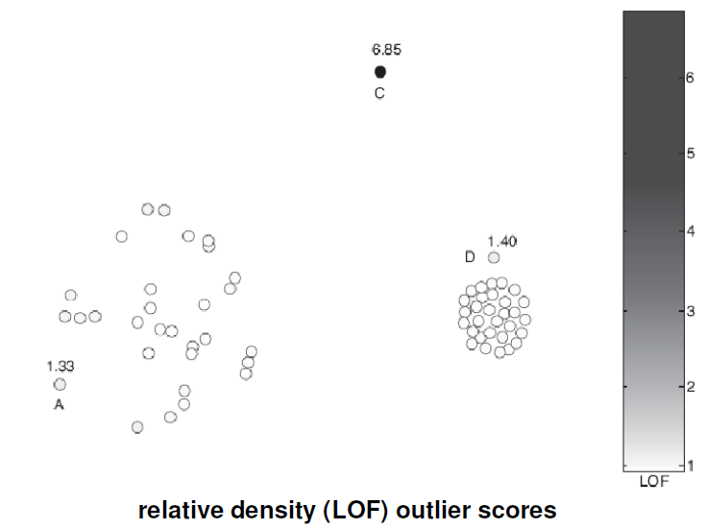

Techniques for unsupervised anomaly detection (2)
Density-based: anomalous data are those that are in regions of low density and are relatively distant from other data.
Outlier score is inverse of density around object.
Scores usually based on proximities.
E.g., based on average distance to k nearest neighbors.

Slide 40


Techniques for unsupervised anomaly detection (2)
Clustering-based: outliers are objects that do not belong strongly to any cluster.
Assess degree to which (distance or relative distance to cluster centers) object belongs to any cluster (e.g. through k-means).
Eliminate object(s) to improve objective function.
Discard small clusters far from other clusters. Sensitive to number of clusters chosen.

Slide 41
5. Real-world issues in anomaly detection
Data often streaming, not static
Credit card transactions
Anomalies can be bursty
Network intrusions
How to employ contextual or structure information?
Contexts: time, location, other situational information
Graph/Networks and other correlation of data

Slide 42
Thanks for your attention!

Slide 43
Appendix 1. https://www.coursera.org/learn/social-network-analysis/home/week/ 2. https://www.coursera.org/learn/python-social-network-analysis 3. Some slides taken or adapted from: “Anomaly Detection: A Tutorial” ArindamBanerjee, Varun Chandola, Vipin Kumar, Jaideep Srivastava, University of Minnesota Aleksandar Lazarevic, United Technology Research Center 4.http://courses.washington.edu/css581/lecture_slides/18_anomaly_detection.pdf 5. https://courses-archive.maths.ox.ac.uk/node/view_material/53485

